Slide 1
أكـــــاديميــــة طــــويـــق
Scalable Data Science

Slide 2
cuDF: Understsanding performance and visualization
Analyzing Performance by profiling utilities
By: Dr. Afshan Hashmi

Slide 3
Course Objectives:
To introduce the fundamentals of cudf.pandas and its role in accelerating data processing using GPUs.
To equip learners with profiling techniques for optimizing performance and identifying GPU vs. CPU execution in data workflows.
To explore data visualization techniques using third-party libraries like Plotly with cudf.pandas.

Slide 4
Understanding the Basics
When dealing with large datasets, processing speed is crucial. That's where GPUs (Graphics Processing Units) come in, as they're designed for parallel processing, which significantly accelerates data manipulation. However, not all operations can be performed on a GPU. This is where cudf.pandas and its profiling utilities become very useful. Here's a breakdown:
pandas: pandas is a popular Python library for data manipulation and analysis, primarily designed for CPU processing.
cuDF: cuDF is a GPU-accelerated DataFrame library, designed to perform similar operations as pandas but on a GPU, leading to much faster processing for large datasets.
3. cudf.pandas: cudf.pandas acts as an accelerator for pandas. It attempts to execute pandas-like operations on the GPU whenever possible, and if an operation isn't supported by the GPU, it falls back to the CPU.

Slide 5
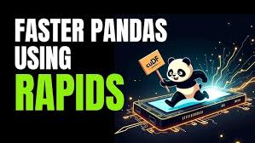
Understanding Performance in cudf.pandas
cudf.pandas provides profiling utilities to help you analyze the performance of your code when working with GPU-accelerated data frames.
These tools help determine which parts of your code ran on the GPU (which is faster for large data processing) and which parts still ran on the CPU (which may be a bottleneck).

Slide 6

Why Profiling is Important:
Identifying Bottlenecks:
If parts of your code are still running on the CPU, those sections can become performance bottlenecks, slowing down the overall process.
The profiling utilities help you pinpoint these CPU-bound sections.
Optimizing Performance:
By knowing which parts of your code are using the GPU and which are using the CPU, you can optimize your code to maximize GPU utilization.
This may involve rewriting certain operations to be more GPU-friendly or minimizing data transfers between the CPU and GPU.
Understanding Execution:
The profiler gives you a clear picture of how your code is being executed, which is valuable for understanding and improving its performance.

Slide 7

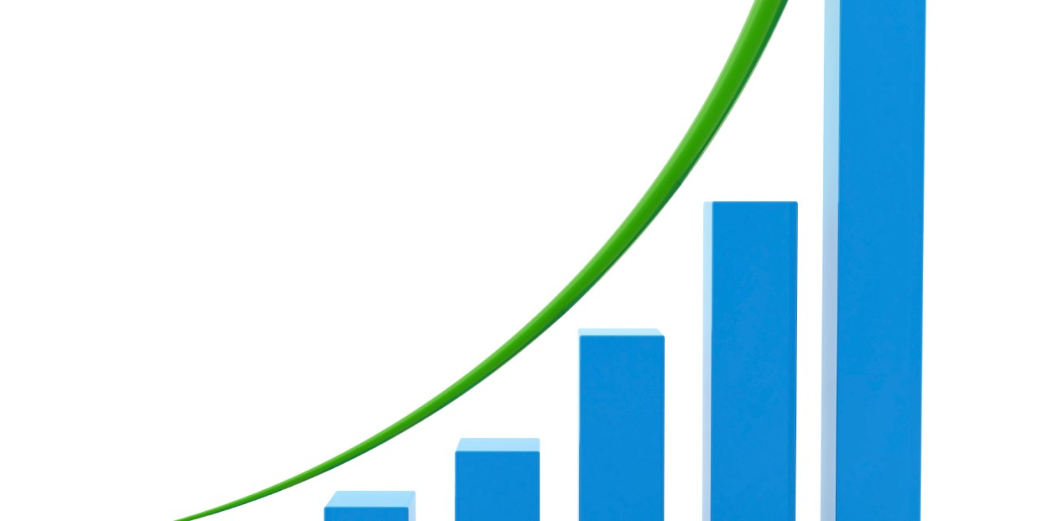
The Goal: Accelerating pandas with GPU Power
Core Functionality:
At its heart, cudf.pandas aims to leverage the parallel processing capabilities of GPUs to drastically speed up data manipulation tasks that are traditionally handled by the pandas library on CPUs.
It acts as a bridge, attempting to translate your familiar pandas code into equivalent operations that can be executed on the GPU.
Performance Gains:
For large datasets, GPU acceleration can result in significant performance improvements, often orders of magnitude faster than CPU-based processing.
The largest gains are seen in operations that can be performed in parallel.

Slide 8
The Insight: Profiling for Performance Analysis
Understanding Execution Flow:
The profiling tools within cudf.pandas provide crucial insights into how your code is actually being executed.
They reveal which portions of your data processing pipeline are being handled by the GPU and which are falling back to the CPU.
Identifying Bottlenecks:
By highlighting CPU-bound operations, the profiler helps you pinpoint potential performance bottlenecks.
These bottlenecks can arise from operations that are not yet supported on the GPU or from inefficient data transfers between the CPU and GPU.
Measuring Success:
The tools allow you to measure how effectively the GPU is being utilized.
This gives you concrete data to understand the performance gains you are receiving.

Slide 9
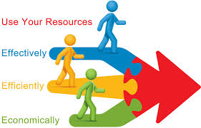
The Action: Optimization and Efficiency
Targeted Optimization:
Armed with the information from the profiler, you can strategically optimize your code to maximize GPU utilization.
This may involve restructuring data manipulations, using GPU-compatible functions, or minimizing data transfers.
Workflow Enhancement:
By optimizing your code for GPU acceleration, you can significantly improve the efficiency of your data processing workflows.
This translates to faster processing times, reduced resource consumption, and improved overall productivity.
Maximizing Potential:
For anyone working with large datasets and seeking to maximize the performance of their cudf.pandas workflows, the profiling utilities are indispensable. They provide the necessary visibility and insights to unlock the full potential of GPU acceleration.

Slide 10

Profiling with cudf.pandas
Profiling utilities allow you to analyze execution time and resource usage helping in optimizing code by identifying CPU-bound operations.
Loading the Extension
To use profiling features, the cudf.pandas extension must be loaded.
Colab Note
If running in Google Colab, the first time you use the profiler, it may take more than 10 seconds due to Colab's debugger interacting with Python’s sys.settrace function.
If it runs slow initially, run the cell again, and it should work fine.

Slide 11
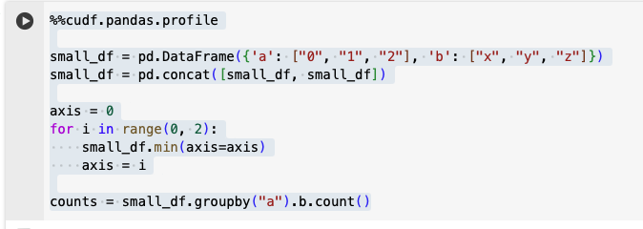
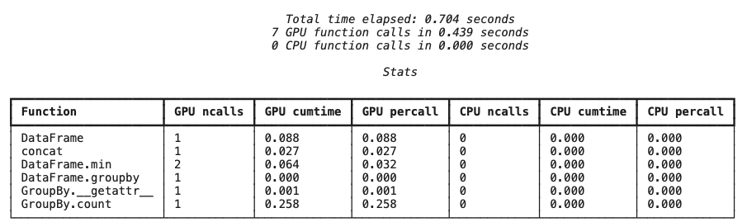
Profiling per function
Pandas.profile gives the detail about each function

Slide 12
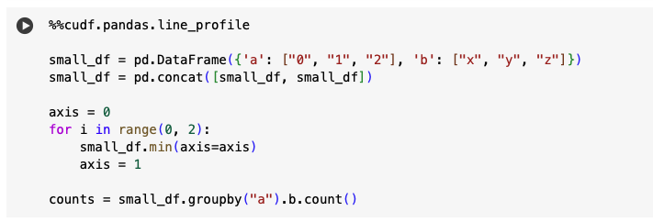
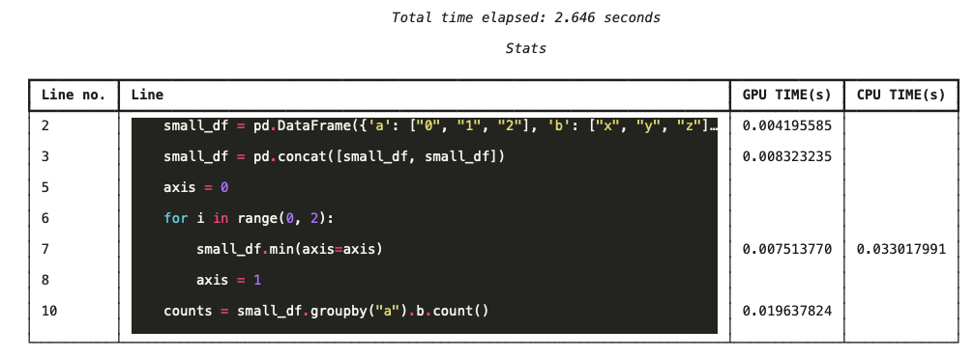
Profiling per line
Pandas.line.profile gives the detail about each line of code

Slide 13

Using Third-Party Libraries with cudf.pandas
The cudf.pandas module in RAPIDS supports interoperability with third-party Python libraries like Plotly, Matplotlib, Seaborn, and Scikit-learn.
This means you can pass cuDF DataFrames (which are optimized for GPU processing) to these libraries just like you would with standard Pandas DataFrames.

Slide 14
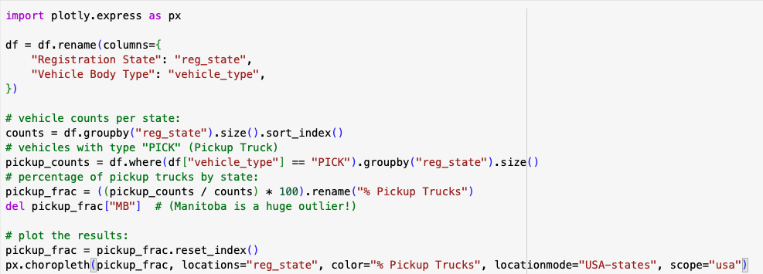
Visualization with Plotly.express

Slide 15
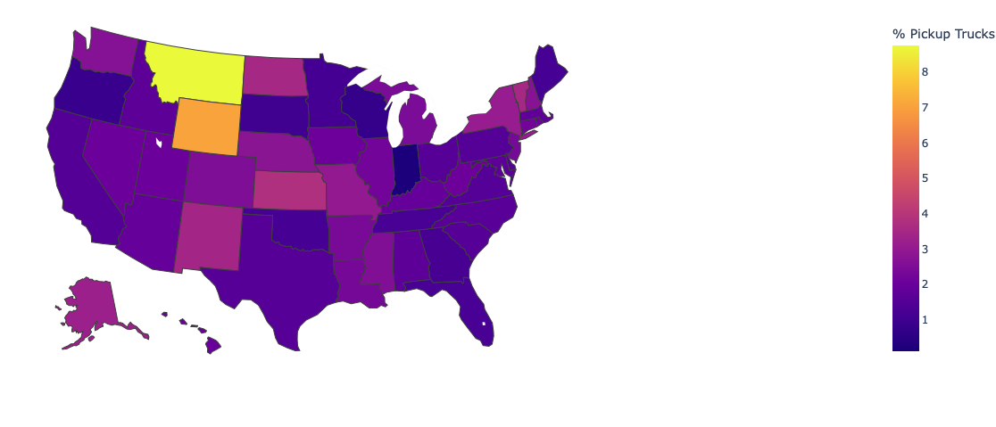
Visualizing which states have more pickup trucks as compared to other vehicles?

Slide 16
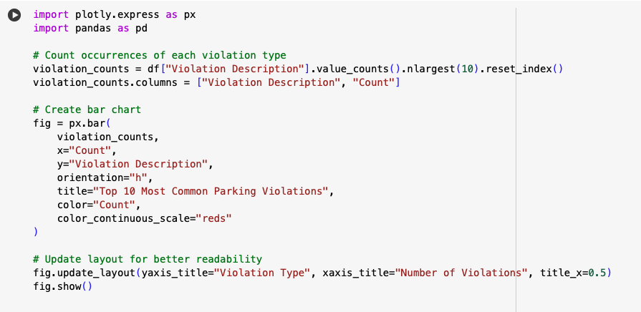
Top 10 Most Common Violations

Slide 17
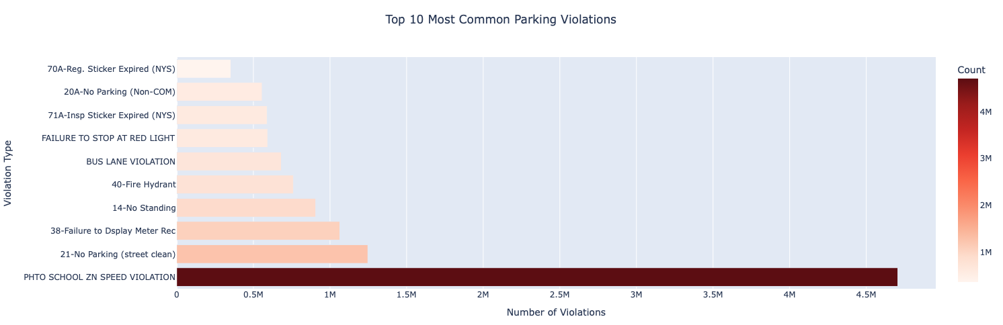
Visualisation of Top 10 Most Common Violations

Slide 18
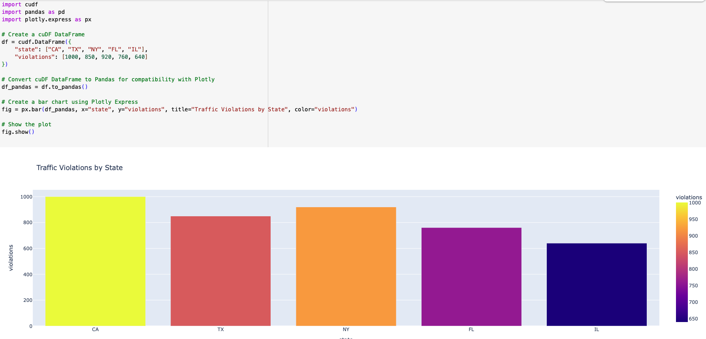
Visualisation of Traffic violation by state

Slide 19
Recap
Understanding cudf.pandas – It enables Pandas-like operations while leveraging GPU acceleration for faster data processing.
Third-Party Library Compatibility – cudf.pandas allows seamless integration with libraries like Plotly but requires converting cuDF DataFrames to Pandas before visualization.
Profiling with cudf.pandas.profile – Profiling tools help identify whether operations run on the CPU or GPU, allowing for optimization.
Optimizing Performance – When using GPU-accelerated pandas libraries, functions like apply() can sometimes result in CPU execution if the applied function is not GPU-compatible. In such cases, if possible, replacing apply() with equivalent vectorized GPU operations can lead to significant performance improvements.
GPU vs. CPU Execution – Operations like groupby(), mean(), and arithmetic calculations are GPU-optimized, while functions like apply() may require manual optimization.
Reducing to_pandas() Calls – Avoid unnecessary conversions from cuDF to Pandas to prevent performance bottlenecks in large datasets.
Best Practices for cuDF Optimization – Use built-in cuDF functions, avoid explicit loops, and prefer vectorized operations for efficient data processing.
Debugging Performance Issues – Profiling reports help pinpoint slow operations, guiding developers to replace inefficient CPU-based functions with GPU-accelerated alternatives.

Slide 20
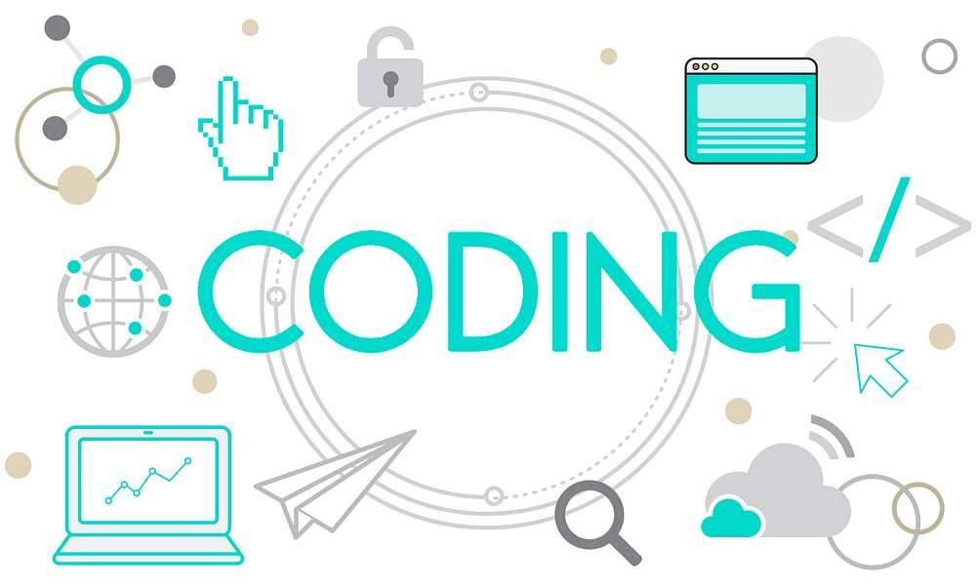
Practical Implementation
Click on the link below to go to Google COLAB
https://colab.research.google.com/drive/1T_IhHxkapwa6vTlOompAo5oHzCYFXDmM - scrollTo=pyVNtGUhtFs5

Slide 21
شــــــكــــرًا لكــــــم
THANK YOU

